Slide 1
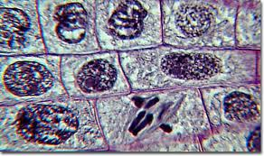
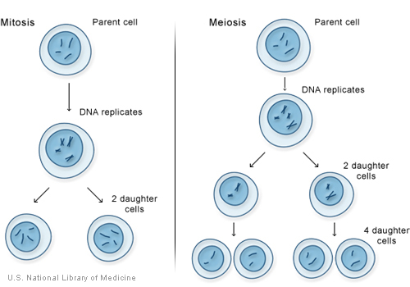
Comparing Mitosis & Meiosis
1. Introduction
1a. In multicellular organisms, there are
2 ways in which a parent cell makes
daughter cells.
1. Mitosis
2. Meiosis

Slide 2
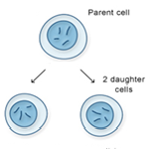
Comparing Mitosis & Meiosis
2. Mitosis
2a. The purpose of mitosis is to make 2 cells whose chromosomes are IDENTICAL to those in the parent.

Slide 3
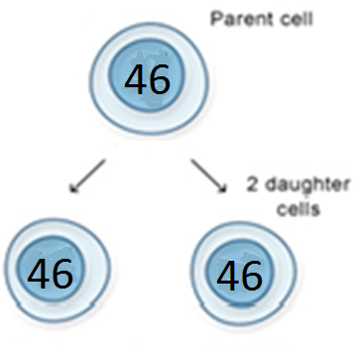
Comparing Mitosis & Meiosis
2. Mitosis
2b. When mitosis takes place in humans:
-Parent Cell = 46 chromosomes (23 pairs)
-Daughter Cell= 46 chromosomes (23 pairs)

Slide 4
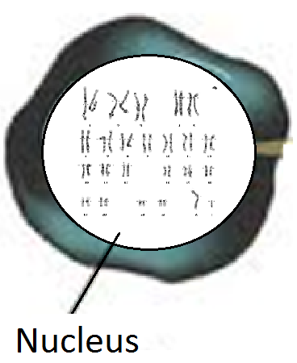
Comparing Mitosis & Meiosis
2. Mitosis
2c. A cell with a complete set of chromosomes is called diploid (abbreviated 2n)
2d. In mitosis both daughter cells are diploid, and are genetically identical to the parent cell.

Slide 5
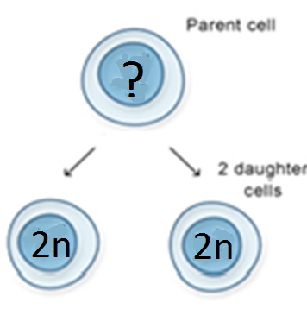
Comparing Mitosis & Meiosis
2. Mitosis
2e. True or False?
- A parent cell that undergoes mitosis can
be described as 1n.

Slide 6
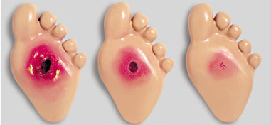
Comparing Mitosis & Meiosis
2. Mitosis
2f. Through mitosis multicellular organisms can:
Make additional cells to grow larger.
Repair damaged tissues
Replace worn-out or dead cells
2g. Cells produced by mitosis are called somatic
cells (body cells).

Slide 7
Check Point 1
A fruit fly cell produced by mitosis has 8 chromosomes.
1) How many chromosomes did the parent cell have?_______
2) How many pairs of homologous chromosomes are in one daughter cell? ______

Slide 8
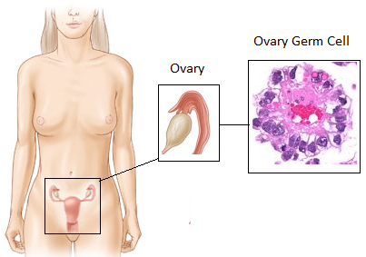
Comparing Mitosis & Meiosis
3. Meiosis
3a. Meiosis happens to only one kind of cell, germ cells (in mammals germ cells are located in the ovaries and testicles)
3b. The resulting cells are called gametes or sex cells (sperm and egg).

Slide 9
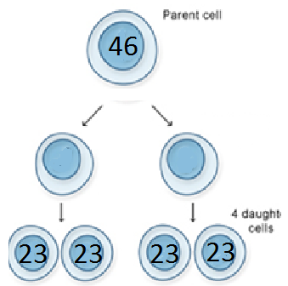
Comparing Mitosis & Meiosis
3. Meiosis
3c. Meiosis produces 4 daughter cells with exactly ½ the number of chromosomes of the parent cell.

Slide 10
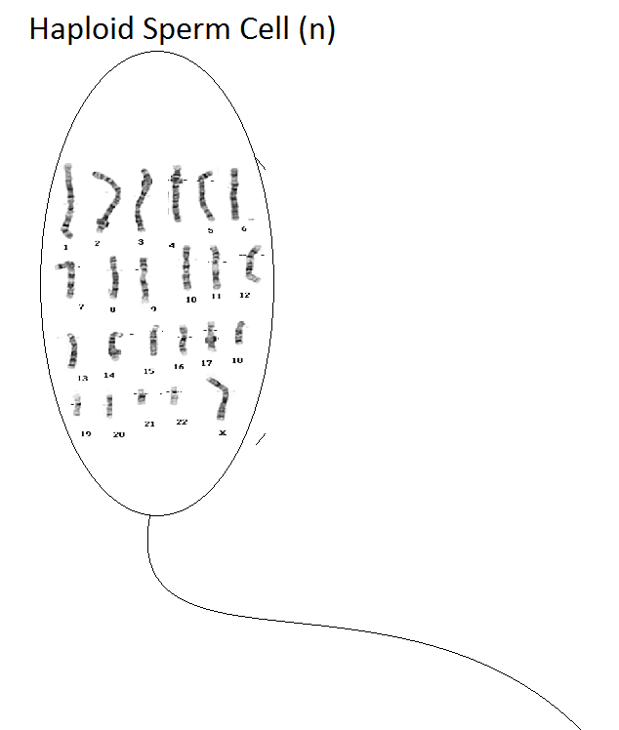
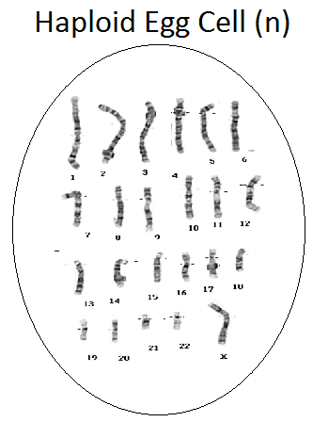
Comparing Mitosis & Meiosis
3. Meiosis
3d. A cell with a ½ set of chromosomes is called haploid (abbreviated n)

Slide 11
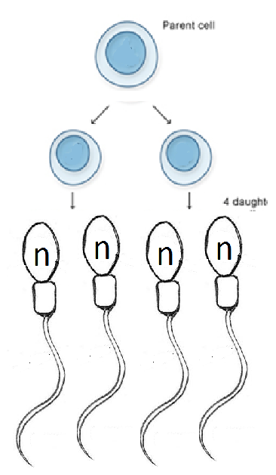
Comparing Mitosis & Meiosis
3. Meiosis
3e. In meiosis all 4 daughter cells are haploid, and are genetically different from each other.

Slide 12
Check Point 2
A dog gamete (egg cell) produced by meiosis has 39 chromosomes.
How many chromosomes did the parent germ cell (in the ovary have) have? _______
How many pairs of homologous chromosomes did the parent cell have? ________

Slide 13
ASSIGNMENTS
Voc. Review - Fill in the blank
Study Guide (30 min)
Kahoot it / Quizzes

