Slide 1
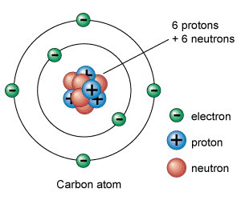
Organic Compounds
1. How atoms combine to form molecules
1a. Atoms are made of:
Protons & neutrons (in the nucleus)
Surrounded by electrons

Slide 2
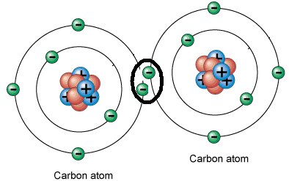
Organic Compounds
1. How atoms combine to form molecules
(continued)
1b. Atoms attach to one another by “sharing” electrons. This is called a covalent bond.
1c. Each line between the atoms represents a covalent bond

Slide 3
Organic Compounds
2. Organic Compounds
3. Why is carbon so important to organic molecules?
2a. Contain carbon atoms
3a. Carbon atoms can bond with themselves, over and over again to form long chains.

Slide 4
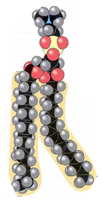
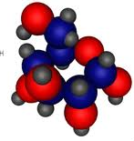
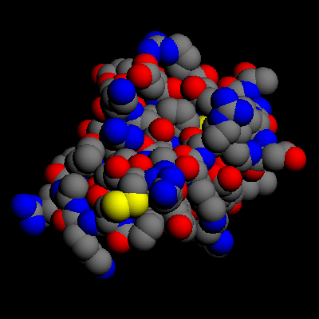
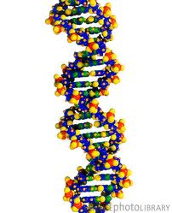
Organic Compounds
4. Cells are made from four different organic molecules
4a. Lipids
4b. Carbohydrates
4c. Proteins
4d. Nucleic Acids

Slide 5
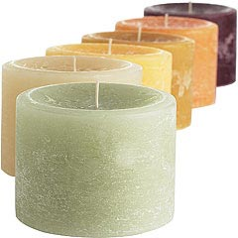
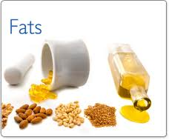
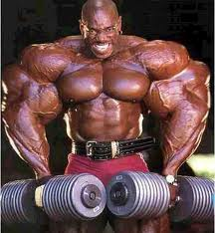
Organic Compounds
5. Lipids
5a. Includes:
Fats
Waxes
Steroids
Phospholipids
5b. Cells use lipids to:
Build membranes & protective layers
Store energy
Communicate between parts of the cell

Slide 6
Organic Compounds
5. Lipids (continued)
5c. Lipids are made of long chains of carbon atoms called polymers.
5d. They are hydrophobic which means “water fearing

Slide 7
Organic Compounds
5. Lipids (continued)
5e. Phospholipids are special lipids.
The head is “polar” meaning it has a slight electric charge that attracts other “charged” molecules like water.
The head is called hydrophilic which means “water loving”
The tails are “nonpolar” and considered hydrophobic

Slide 8
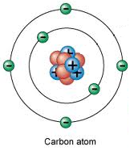
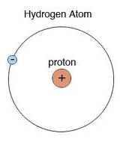
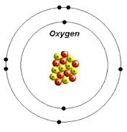
Organic Compounds
6. Carbohydrates
6a. Include:
Sugars
Starches
Cellulose
6b. All carbohydrates are made of 3 elements:
Carbon (C)
Hydrogen (H)
Oxygen (O)

Slide 9
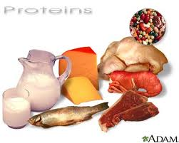
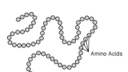
Organic Compounds (part 2)
7. Proteins
7a. Long molecules built out of smaller molecules called amino acids
7b. Functions:
Provide structure for cells & tissues
Needed for cell growth, repair, and division.
Act as enzymes

Slide 10
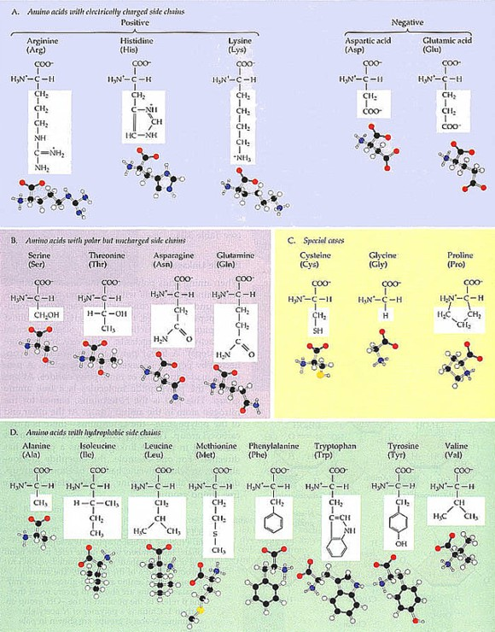
Organic Compounds (part 2)
7. Proteins
(cont…)
7c. Humans have about 2,000 different proteins all made from different combinations of 20 amino acids.

Slide 11
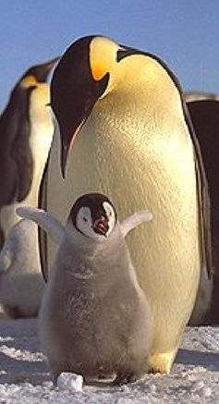
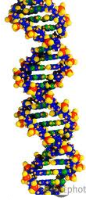
Organic Compounds (part 2)
8. Nucleic
Acids
8a. Contain all the instructions for cell
growth and repair.
8b. 2 important types:
Deoxyribonucleic Acid (DNA)
Ribonucleic Acid (RNA)
8c. DNA controls heredity (the passage of
genes to offspring)

Slide 12
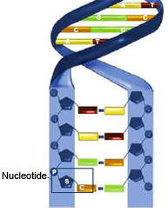
Organic Compounds (part 2)
8. Nucleic
Acids
(cont…)
8d. Nucleic acids are made of smaller units called nucleotides.
8e. Atoms involved in building nucleotides:
Carbon
Hydrogen
Oxygen
Nitrogen
Phosphorus

Slide 13
Assignment:
Organic Compounds Worksheet
1st page use “Organic Compounds” Notes
Reading Questions: use attached reading.

